Slide 1
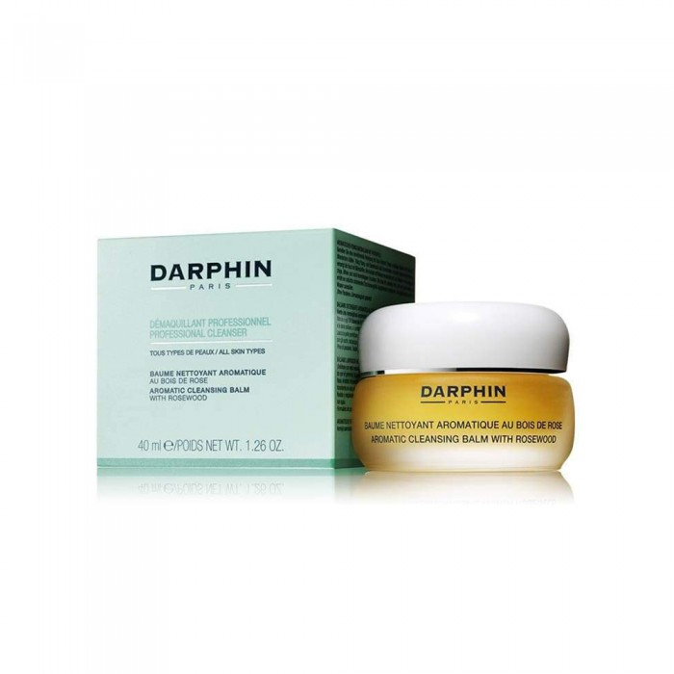
Darvin
Darvin Conditioner Cleaner and Makeup Remover 40 ml
253.00 SAR.
Usage Method:
- Apply a small amount to the moisturizing face with a light massage and wash thoroughly
- Twice daily

Slide 2
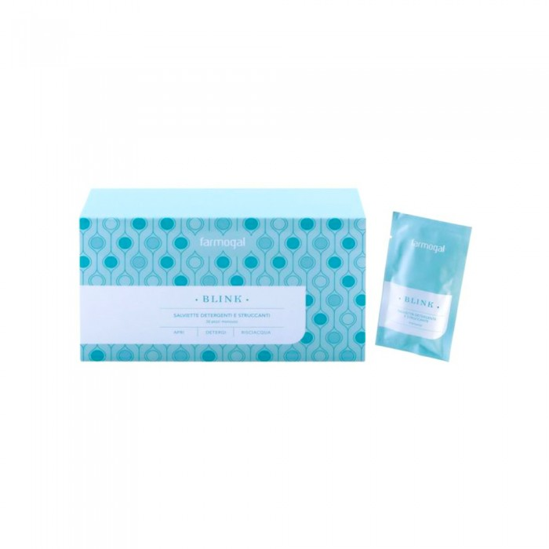
Farmogal
Pharmacal Wipes For Makeup Removal With Perfect Moisturizing 30 Wipes
178.25 SAR. Q
- Makeup removal wipes are rich in hyaluronic acid and vitamin pro with a distinctive formula that not only cleanses and cleanses the skin but also restores its freshness and flexibility
- Leave no trace of makeup so as not to clog the pores and thus protect the skin from exposure to acne-causing bacteria
- Each wrapped tissue to keep the packaging safe and valid for as long as possible
Usage Method:
Easy to use just remove the wrap from the napkin and make circular movements on the face, neck and around the eyes to remove the makeup, then rinse with water.

Slide 3
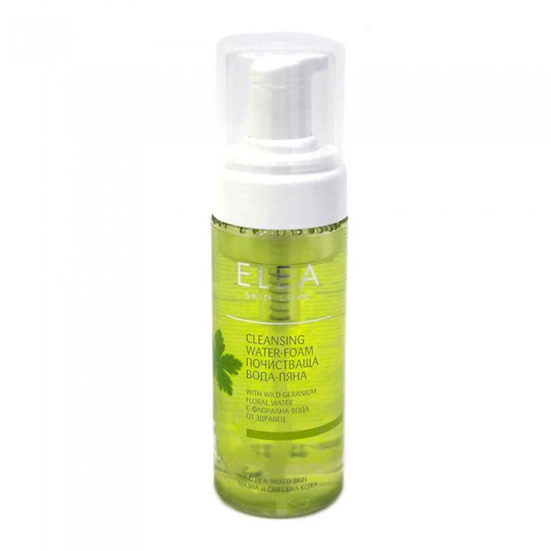
Elijah
Elijah foam lotion for oily skin 165 ml
148.35 SAR. Q
- Gentle water foam designed to clean oily and mixed skin. Removes impurities and makeup without drying the face.
- Soap-free and balanced formula containing wild blossom water and moisturizer - restores optimal moisture balance, has anti-inflammatory and soothing effect.

Slide 4
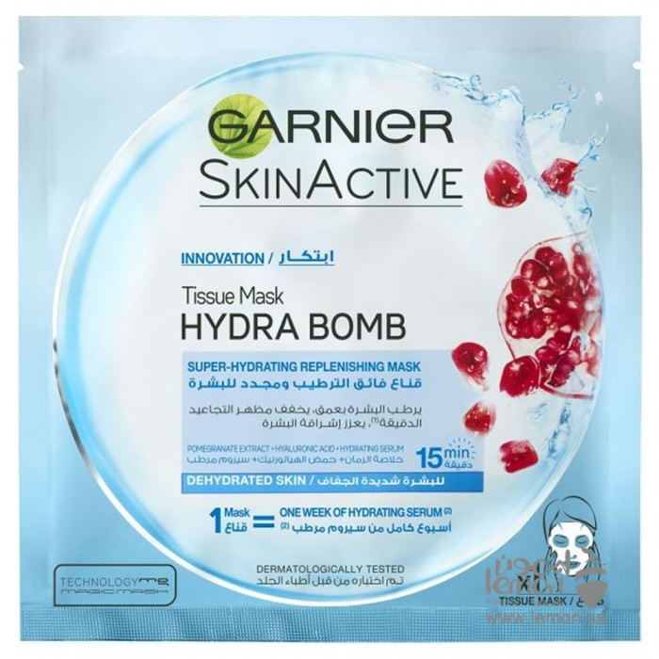
Garnier
Garnier Intense Moisturizing and Skin Rejuvenation Mask Hydra Pump With Pomegranate Extract
12.71 SAR. Q

Slide 5
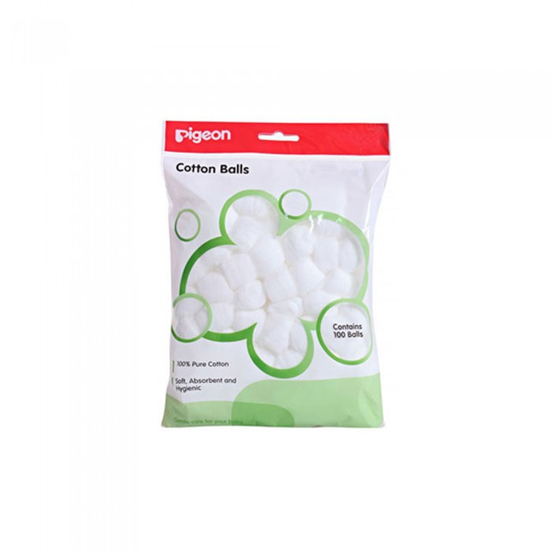
Biegun
Pigeon White Round Cotton Balls 100 Pills
17.25 SAR. Q
- Made of 100% pure cotton
- Soft, absorbent and healthy
- Perfect for all your family's needs, skincare products and childcare

Slide 6
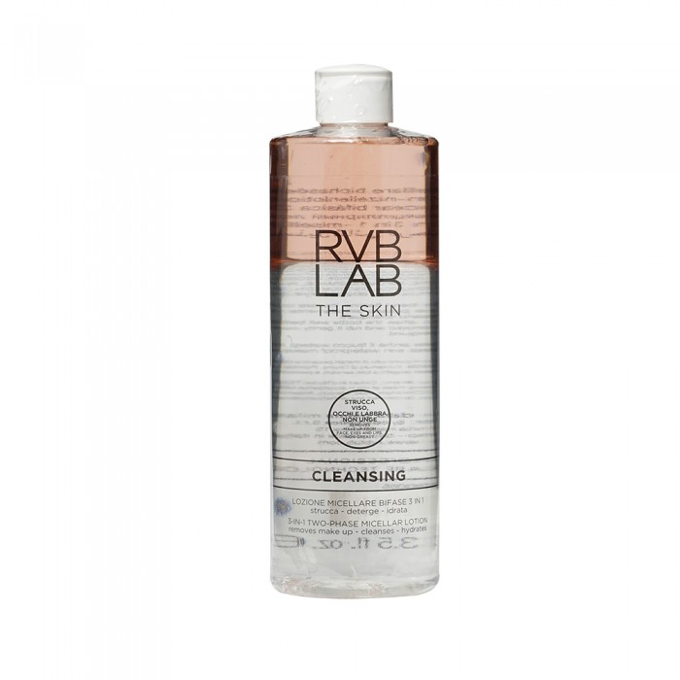
RVP
RVB 3 in 1 Mislar Lotion Makeup Remover 400 ml
182.85 SAR. Q
- Removes makeup, cleans and moisturizes skin.
- Innovative two-stage synergistic formula: Phase 1 cleans and removes air impurities, leaving skin pure and clean. The second phase quickly removes makeup residue, even long-lasting products and waterproof, leaving skin smooth and moist.
- The formula does not leave skin oily and is suitable for removing eye makeup and for all skin types even sensitive skin.
Method of use:
Soft cotton balls are wet with the product and used for facial cleaning

